Slide 1
Framing Research as Evaluation and Assessment
Introducing CORDA
Paul Conway, University of Michigan
Jennifer Gunter King, Emory University
Notes:
Thank you for the opportunity to speak to the Research Forum this year in what I hope will be a timely and relevant briefing, and one that might be a little provocative too.
I am Paul Conway – this is my 6th Research Forum talk or poster. I am also the new co-chair of the brand new SAA Committee on Research, Data, and Evaluatino

Slide 2
Provocative Ideas
Archivists don’t do research and rarely ever have.
Archivists have a long tradition asking and answering good questions
about of what we do, who we serve, and our impact in the wider world.
Archivists need better tools for doing rigorous assessment and evaluation and then saving and sharing the results (widely).
Notes:
I would like to start with a provocative idea – designed to challenge us to think outside the box and certainly outside some of the stories we have been telling ourselves as archvists for at least 35 years, probably longer.
Here is my provocative idea.
Archivists don’t do research and rarely ever have. Not for wont of trying. Not for articulating research agendas. Not for building an impressive educational system with faculty, doctoral students, and masters degree students across the country in North America and across the globe.
What we have done and what me must continue to do is rigorous assessment and evaluation.
For the next fifteen minutes, I want to pitch this idea and then turn over the podium to my co-chair of CORDA, Jennifer Gunter King, who will introduce the new SAA Committee.

Slide 3
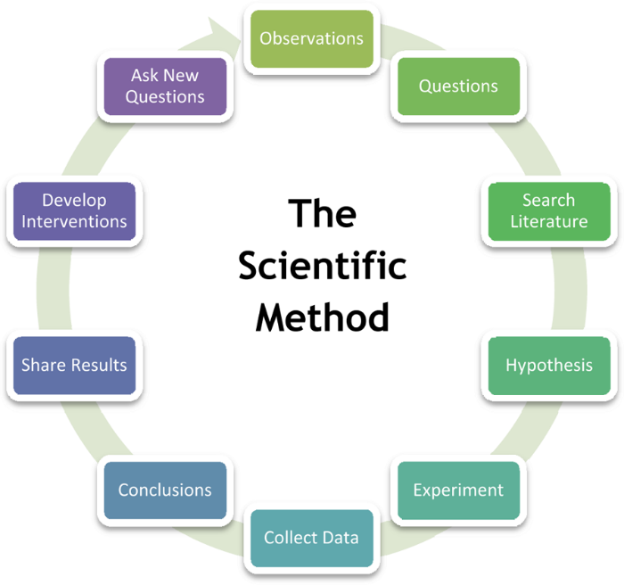
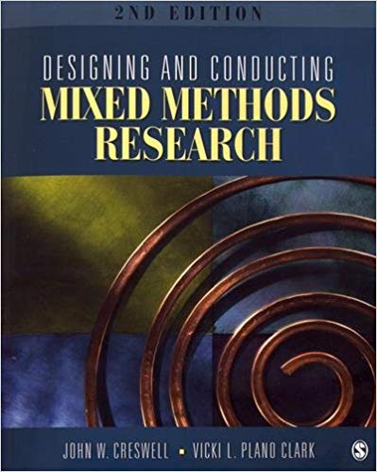
What is Research?
John W. Creswell
Notes:
Research contributes to the societal knowledge base. Research stands explicitly on prior knowledge. Research is iterative. Research is driven by testable hypotheses. Research is explicit about the connection between the question, the method, and the interpretation of the outcome.
The cyclical nature of the scientific method easily encompasses disciplinary, multi-disciplinary, and cross-disciplinary inquiry. The scientific method embraces quantitative, qualitative, and mixed methods of data gathering. The scientific method is flexible about the form of publication and the nature of the review prior to dissemination. That said, however, without hypothesis-driven questions, a rigorous method, and transparent dissemination, there is no research.
Mention John W. Creswell. Education research and multi-method research.
In this regard essays, advocacy, and research agendas are not research. In addition, internal studies, accumulated transactional data, and white papers are not research, even though they may have a thorough command of the literature and the marshaling of evidence.
Disciplines where research is at the center of the enterprise, whereas professions establish and maintain distinctions between the research function and the clinical learning function – think medicine, law, education.
The corporate sector does research to serve their own capitalistic ends. Our mission is the greater good of society, and always has been.

Slide 4
The Archival Knowledge Base
Published literature
A growing number of journals – peer review, commitment to open access
Decades of publishing in book form – sole author, multi author, chapter books, text books, assembled works
Counting and measuring
From Ernst Posner (1956) forward – surveys and censuses
Reporting, framing, agenda setting
Planning and Building
Goals and Priorities (in earnest since mid-1980s)
Agenda setting for the profession and SAA
Notes:
A vibrant knowledge base is a fundamental requirement of a thriving profession. This archival knowledge base is alive and well.
The American Archivist in its 82nd year. Archivaria in its ?? Year. Archival Science in 19th year.
Growing number of journals, peer review of various sorts and strong commitment to open access.
Growing variety of other outlets ranging from blogs, podcasts, and a lively social media presence.

Slide 5
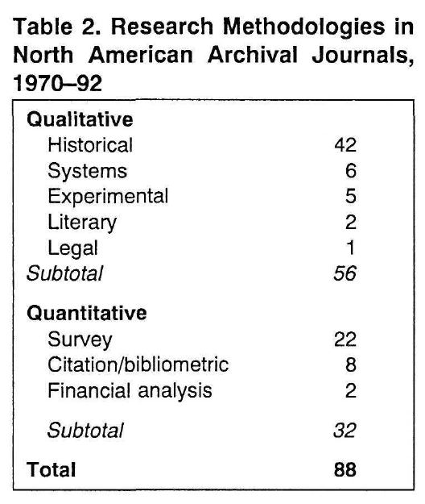
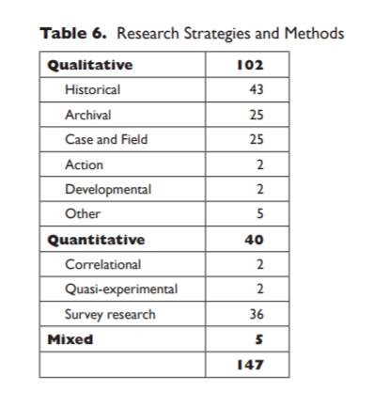
Research Issues and Methods
Cox (1992) and Conway (2013)
Notes:
Richard Cox, in his seminal 1986 article about the knowledge requirements for the archival profession, called for a deep investigation into three areas: educational requirements, the feasibility of individual certification, and the desirability of program accreditation. We have pursued all three with a mix of success and frustration.
At least two studies have looked broadly at the extent to which archivist are doing the research needed to advance these major requirements of a profession. Cox (1992) and Conway (2013) are two of them. Here is a side by side comparison of one of the tabled from these two articles.
The tables show that about a third of the articles published in certain archival journals over certain periods of time are research oriented. Some favored methods.
What may be most striking however, is how few of these research articles concern the most pressing issues of the archival profession itself.
Report on Articles with “research in the title” 70 articles. Three-quarters on other aspects of research. Fourteen articles – five agenda, 6 education for professional research, xx on the

Slide 6
Three Waves of Research Agendas
The Archival Profession – 1986-1991
Appraisal – Richard Cox and Helen Samuels
Management – Paul H. McCarthy
Users and Use – Lawrence Dowler
Electronic Records – Margaret Hedstrom
Research and Education (2000 to present)
SAA Task Force – CORDE (2017- to present)
Diversity & demographics; Metrics and institutions; Functional needs assessment; Inclusive collaboration; Audience building
Notes:
Not for wont of trying.
CGAP – planning for the profession. Three waves of research agendas.

Slide 7
Research for/in Archival Education
Eric Ketelaar: Archivistics saving the profession (2000)
“Education needs research, and research needs education” (333).
Archival Education and Research Initiative – 1980s to present
Building a cadre of faculty (Burke, Conway, and onward)
Yakel, Gilliland and McKemmish on research infrastructure
Research and Archival Education Curricula – (2000 onward)
Multiverse, DigCCur and digital curation, etc.
Graduate Education Guidelines
Avoiding accreditation but supporting archival identity
Notes:
Much deeper pursuit of research and education. Not sufficient time to provide the details.
Ketelaar – visionary call for archivistics as a research construct at the center of the archival profession.
Growth of faculty – Burke/Conway through AERI.
Deep dives into curriculum development
Iterative efforts to characterize the professional knowledge, skills and aptitudes needed to enter and continue successfully in the archival profession. Also allied areas of digital curation, very broadly construed.
The wall and the moat. It’s ok. In a growing and vibrant profession it is fine to establish and reinforce the distinctions between the research function and the clinical function – the latter area where archivists can do the best work and make the biggest impact.

Slide 8
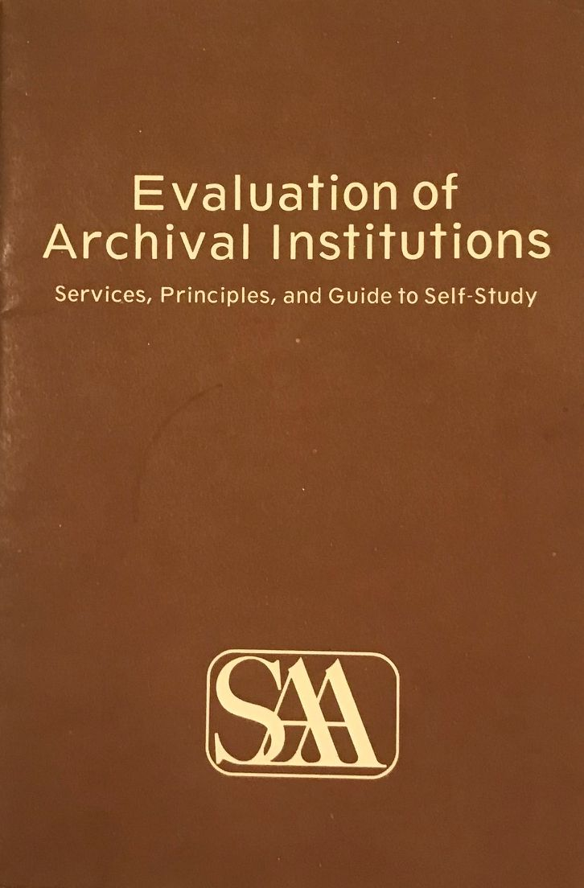
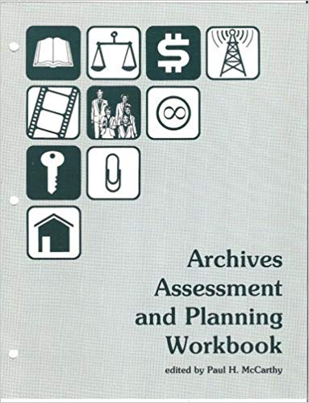
Institutional Evaluation – Ebb and Flow
1. Legal Authority and Purpose
2. Governing Authority and Administration
3. Financial Resources
4. Staff
5. Physical Facilities
6. Building Archival and Manuscript Holdings
7. Preserving Archival and Manuscript Holdings
8. Arrangement and Description
9. Access Policy and Reference Services
10. Outreach and Public Programs
Principles, 1982
McCarthy Workbook, 1989
Notes:
1976 presidential address by Robert M. Warner.
1980 SAA Newsletter
Principles (1982) and Workbook (1989) – including census data from 1985 – the major study prior to the A*Census in 2004 (published in 2006).
Institutional evaluation and possible program accreditation set aside in 1994 in favor of deepening support for individual certification and the iterative development of educational guidelines.
Consider rattling off the ten areas where the principles live. Put them underneath these booklet pages.
Throwback in a way. But if each of these principled area of practice were viewed also through the lenses of community/indigenous archives, diversity/equity/inclusion, post custodial/post modern archives, social justice and the archive, it is feasible that evaluating and assessing the domain of practice can encompass traditional approaches and new approaches that are increasingly aware of the contingent nature of archives in society.

Slide 9
A Pitch for Evaluation & Assessment
Principles-based – requiring a framework of issues but no explicit agenda.
Bottom up – finding priorities from the needs of the profession
Practice-based – rigorous and systematic but not dependent on hypotheses
Open, transparent, and shared – most likely through a flexible digital repository platform
Two-way collaboration with the academy – modeled on the research-clinic system
Respectful of the wall/moat between formal scholarship and assessment activities
Realistic about the grand challenges of the archival community
Pragmatic about archives as a site of inquiry
Strategic about contracting for studies with the academy
Notes:
A return to first principles, recognize the priorities and limitations of individual archivists, archivial organizations, and the support structures of the profession – beginning but certainly not ending with the Society of American Archivists.
Ernst Posner made this call in 1956. Richard Cox made this call in 1986. Dennis Meissner made this call in 2016. We are ready to get this done.
We don’t do research outside the academy and we don’t need to. What we need are the tools and support required to do a better job knowing and sharing data on who we are, what we do, who we serve, and the impact of our work beyond the four walls of our organizations.

Slide 10
CORDA Origin Story
2016: Dennis Meissner SAA presidential address, “Bare Necessities”
2016: President Meissner Proposal for a Committee on Research and Evaluation (CORE)
May 2017: SAA Council charged the Task Force on Research/Data and Evaluation (TF- CORDE)
comprised of Chair Michelle Light and member Sarah Buchanan, Mahnaz Ghaznavi, Dennis Meissner, Daniel Noonan, and Stacie Williams
November 2018: SAA Council establishes Committee on Research, Data and Assessment
March 2019: CORDA launched

Slide 11
The CORDA Charge
The Committee on Research, Data, and Assessment provides access to significant and useful data and research
about SAA, American archives, and their users
that evidence the value of archives for society
and help us improve our services to SAA members and to our consumers.
The Committee will work to conduct or support relevant research and to create, gather, and preserve data by directing and engaging in several areas of activity
.
www2.archivists.org/governance/handbook/section7/groups/Research-Data-Assessment

Slide 12
CORDA Members
Paul Conway, University of Michigan (co-chair)
Jennifer Gunter King, Emory University (co-chair)
* Sarah Buchanan, University of Missouri Columbia
Courtney Dean, University of California, Los Angeles
Amanda Hawk, Louisiana State University, Baton Rouge
Cristina Horak, Federal Reserve Bank of Dallas
Chris Marino, Environmental Design Archives, UC Berkeley
* Dennis Meissner, Retired
Erin Passehl Stoddart, University of Oregon
Sarah Pratt, Simmons University
Ricky Punzalan, University of Maryland
* Member of Task Force-CORDE

Slide 13
CORDA Priorities
Standardized Tools for gathering and analyzing data
Centralized repository
Training on gathering, analyzing, interpreting and using data
Up-to-date basic facts and figures about archives and archivists
Research Priorities

Slide 14
CORDA Priorities – A Three Year Plan
We hope you will join the Committee on Research, Data and Assessment
Join us on Sunday from 12:00 – 1:15 pm for a noon-time forum and brown bag to discuss priorities for
Year 1
Year 2
Year 3 – and beyond
We will share more on how you can be involved and participate!

Slide 15
Thank you!
Contact us: corda@archivists.org

Slide 16
References [1]
AERI. (2011). “Educating for the Archival Multiverse.” American Archivist 74 (1): 69-101.
* Benoit, Edward & Donald C. Force. (2019). “One Size Does Not Fit All: Graduate Archival Education in the Twenty-First Century.” American Archivist 82 (1): 24-52.
Code of Federal Regulations. 45 CFR 46.102(l). “Public Welfare: Protection of Human Subjects: Definitions for purposes of this policy: Research.” https://www.ecfr.gov/cgi-bin/text-idx?SID=aae75c7cb17f345fd554e5cfd55df0c0&mc=true&node=se45.1.46_1102&rgn=div8
* Conway, Paul. (1986). "Facts and Frameworks: An Approach to Studying the Users of Archives." American Archivist 49 (Fall): 393-407.
* Conway, Paul. (1987). “Perspectives on Archival Resources: The 1985 Census of Archival Institutions.” American Archivist 50 (2): 174-191.
* Conway, Paul. (2013). “New Culture of Scholarship: An Analysis of North American Archival Research Articles,” American Archivist Online Supplement to Volume 74 (306): 1-15.
* Cox, Richard. (1986). “Professionalism and Archivists in the United States.” American Archivist 49 (3): 229-247.
* Cox, Richard. (1994). “An Analysis of Archival Research, 1970-92, and the Role and Function of the American Archivist.” American Archivist 57 (2): 278-288.
* Creswell, John W. (2008). Educational Research: Planning, conducting, and evaluating quantitative and qualitative research (3rd ed.). Upper Saddle River: Pearson.
* Creswell, John W. and Vicki L. Plano Clark. (2011). Designing and Conducting Mixed Methods Research (2nd ed.). Los Angeles: Sage.
* Duff, Wendy, Elizabeth Yakel, Helen Tibbo, Joan Cherry, Aprille McKay, Magia Krause, & Rebecka Sheffield. (2010). “The Development, Testing, and Evaluation of the Archival Metrics Toolkits.” American Archivist 73 (2): 569-599.
* Gilliland, Anne, McKemmish, Sue M., & Lau, Andrew J. (2017). Research in the Archival Multiverse. Clayton Victoria AUS: Monash University Publishing.
* Gilliland, Anne. & McKemmish, Sue. (2004). “Building an Infrastructure for Archival Research.” Archival Science 4 (3-4): 149-197. https://doi.org/10.1007/s10502-006-6742-6

Slide 17
References [2]
* Grimard, Jacques & Pagé, Lucie. (2005). “Towards Program Evaluation in Archives.” Archival Science 4 (1-2): 69-125. https://doi.org/10.1007/s10502-005-6992-8
* Grimard, Jacques. (2004). “Program Evaluation and Archives: ‘Appraising’ Archival Work and Achievements.” Archivaria 57 (Spring): 69-87.
* Hedstrom, Margaret. (1991). “Understanding Electronic Incunabula: A Framework for Research on Electronic Records.” American Archivist 54 (3): 334-354.
* Huvila, Isto. (2008). “Participatory archive: Towards decentralised curation, radical user orientation and broader contextualisation of records management.” Archival Science 8 (1): 15–36.
Katuu, Shadrack. (2015). "User studies and user education programmes in archival institutions", Aslib Journal of Information Management 67 (4): 442-457. https://doi.org/10.1108/AJIM-01-2015-0005
* Ketelaar, Eric. (2000). “Archivistics Research Saving the Profession,” American Archivist 58 (4): 494-507.
Linn, Mott. (2015). “Not Waiting for Godot: The History of the Academy of Certified Archivists and the Professionalization of the Archival Field.” American Archivist 78 (1): 96-132.
McCarthy, Paul H. (ed.). (1989). Archives Assessment and Planning Workbook. Chicago: Society of American Archivists. https://www2.archivists.org/sites/all/files/ArchivesAssessPlanWkbkAug2010.pdf
Meissner, Dennis. (2017). “Bare Necessities.” American Archivist 80 (1): 6-18.
OECD. (2015). Frascati Manual 2015: Guidelines for Collecting and Reporting Data on Research and Experimental Development, The Measurement of Scientific, Technological and Innovation Activities, OECD Publishing, Paris, https://doi.org/10.1787/9789264239012-en
Palm, Charles. (1988). “Introduction to Archival Research Agendas.” American Archivist 51 (1-2): 23-27.
Posner, Ernst. (1957). “What, Then, Is the American Archivist, This New Man?” American Archivist 20 (1): 3-11.
* Rhee, Hea Lim. (2015). “Reflections on Archival User Studies.” Reference & User Services Quarterly 54 (4): 29-42.

Slide 18
References [3]
SAA. (1980). “Report of the Task Force on Institutional Evaluation.” SAA Newsletter, January 1980, pp. 7-14. https://www2.archivists.org/node/21118
SAA. (1994). Guidelines for Evaluation of Archival Institutions. https://www2.archivists.org/groups/standards-committee/guidelines-for-evaluation-of-archival-institutions
SAA. (2017). Task Force on Research/Data and Evaluation. Recommendation to Establish a Committee on Research, Data, and Assessment. https://www2.archivists.org/sites/all/files/1118-IV-A-TF-CORDE_0.pdf
SAA. (2018). Committee on Research, Data, and Assessment. Charge. https://www2.archivists.org/governance/handbook/section7/groups/Research-Data-Assessment
* Stephenson, Mary Sue. (1991). “Deciding Not to Build the Wall: Research and the Archival Profession.” Archivaria 32 (Summer): 145-151.
Tansey, Eira. (2015). “The landscape of archival employment: A study of professional archivist job advertisements, 2006-2014.” Archival Practice (2). http://libjournal.uncg.edu/index.php/ap/article/view/1084
* Ciaran B. Trace & Carlos J. Ovalle. (2012). “Archival Reference and Access: Syllabi and a Snapshot of the Archival Canon.” The Reference Librarian 53 (1): 76-94, DOI: 10.1080/02763877.2011.596364
Wilczek, Eliot & *Heather Soyka. (2018). “The Formulation of Grand Challenges within AERI Scholarship, 2009-2018.” Presentation slides delivered at SAA Research Forum, August 2018. https://www2.archivists.org/sites/all/files/102_saaresearchforum_2018_presentation_wilczek_live.pptx
* Yakel, Elizabeth. (2000). “Introduction: Graduate Level Archival Education Comes of Age.” American Archivist 63 (2): 220-223.
* Yeo, Geoffrey. (2018). Research in the Archival Multiverse (review).” American Archivist 81 (1): 249-253.

